Slide 1
Mars: Science and Engineering (Week 4)
Howard Seltman
CMU Osher
Fall 2023

Slide 2
Course Outline
Week 1
  Astronomy background
  Early flights with no or minimal success
  Mariner Program
Week 2
  1973: Soviet Mars program
  1975: US Viking program
  1990s: MGS, Pathfinder, Sojourner, Nozomi
Week 3
  Early 2000s: Odyssey, Spirit & Opportunity, Mars Express
  Late 2000s: Mars Reconnaissance Orbiter, Phoenix lander
Week 4
  2010s: Curiosity, MAVEN, Mangalayan, Insight
  2020s: Perseverance, Ingenuity, Tianwen, Emirati Hope
  Future missions: Exo-Mars, EscaPade, sample return
  Far future: humans on Mars

Slide 4
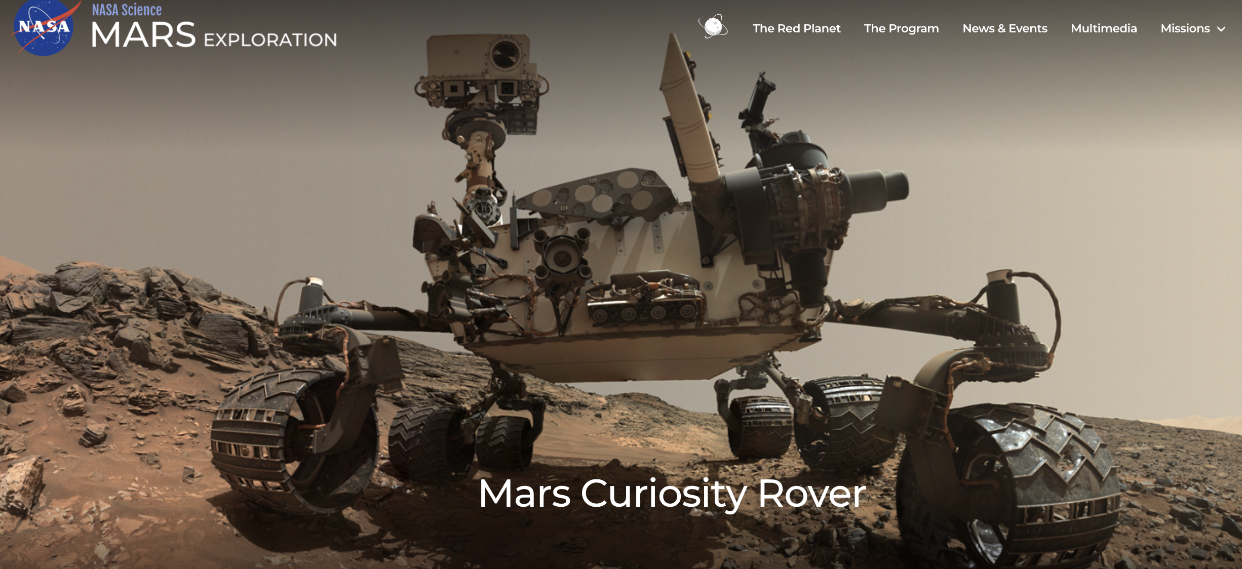
US Mars Science Laboratory aka Curiosity
$2.5 billion rover launched November 2011, landing August 2012
Powered by 10 pounds of plutonium dioxide (t_{½} = 88 years)
Still operating

Slide 5
Curiosity Development
April 2004: Announcement of Opportunity for scientists and engineers from around the world to propose instruments
  Goals: quantitatively assess the habitability and environmental history of the landing site, characterize the geology, investigate planetary processes that influence habitability, and characterize surface radiation
  10 instruments chosen out of 48 proposed
Size and weight of Vikings, but mobile
Goal to reduce landing ellipse from MER’s 90 x 12 miles to 4 x 2 miles (final design: 12 x 4 miles) achieved with steerable aeroshell
Eventual workforce of 800 people
Changed from Super Light Ablator (corkwood, epoxy and gas filled silica glass spheres) to tiled Phenolic Impregnated Carbon Ablator

Slide 6
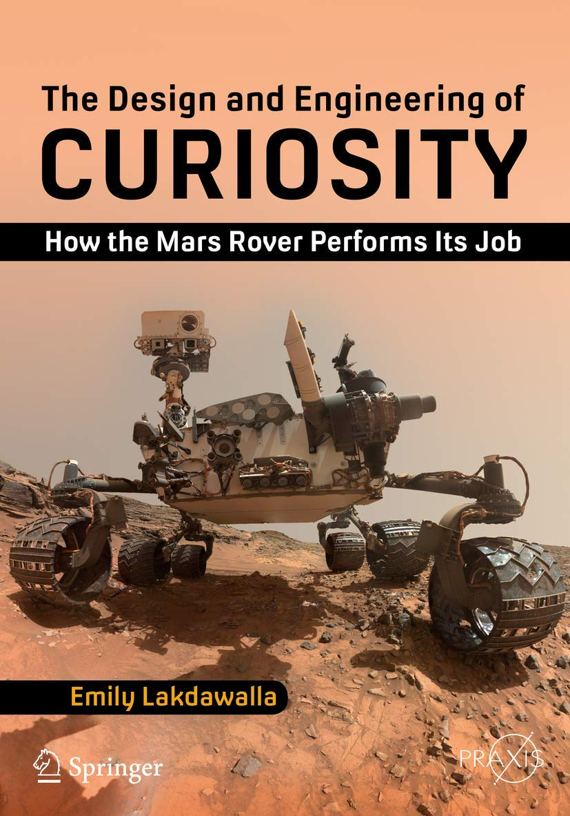
Curiosity Instrumentation
Mostly similar to Spirit and Opportunity
Duplicate computers and navigation imaging
ChemCam (0:30) for laser-induced breakdown spectroscopy
Explanation by Emily Lackdawalla, planetary geologist and space lcscience journalist
CheMin for first direct mineralogy by x-ray diffraction and fluorescence

Slide 7
Curiosity EDL
Added steering capability to the aeroshell to reduced the size of the landing ellipse
Goal to land directly on the rover wheels
Sky crane is straightforward: as soon as the descent phase detects slack in the tether, it can cut the tether and fly away from the landing site
Curiosity EDL (3:41) August 5, 2012
Real Movie of Curiosity Descent (0:55) at 2.5 times normal speed

Slide 8
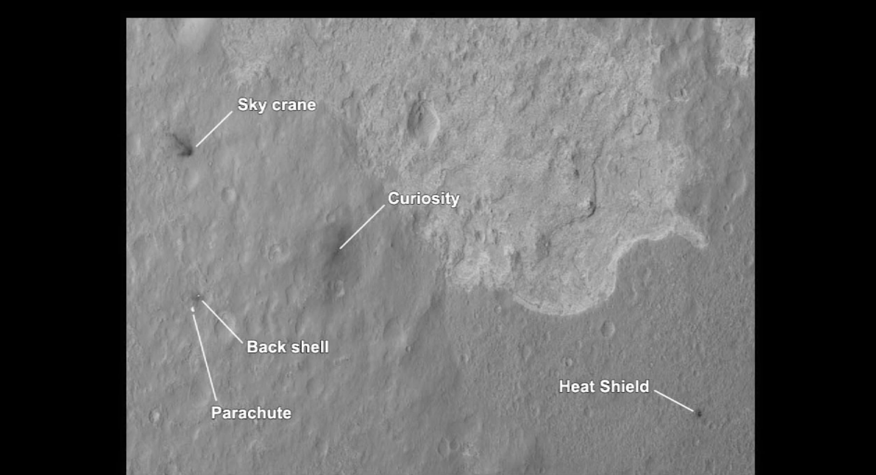
Curiosity Cruise and Landing
During cruise phase measured radiation from galactic cosmic rays and solar coronal mass ejections: one round trip is more than NASA allowable lifetime dose of radiation
Landing Site Gale Crater
  An impact crater 90 miles in diameter and 3 miles deep
  Later filled with sediment (wind and/or water)
  Later eroded around the edges to form central Mount Sharp in the middle
  Alluvial fan in the lowlands

Slide 9
Curiosity First Year
Rogue “pilot” computer
Unexpected wheel damage
Rocks with sand grains too large to be transported by wind is good evidence of flowing water (billions of years ago)
Sample Analysis at Mars (SAM) tunable laser spectrometer (TLS) found no methane in the atmosphere (less than 1 ppb)
TLS measured atmospheric composition much more accurately than ever before: 96.0 % CO₂, 1.9 % Ar, 1.9 % N₂, 0.1 % O₂, 0.06 % CO
SAM found much higher deuterium to hydrogen ratios than on Earth, suggesting preferential loss of lighter elements, which supports the idea that the atmosphere was lost via the solar wind
Combined evidence of habitability (2:37)

Slide 10
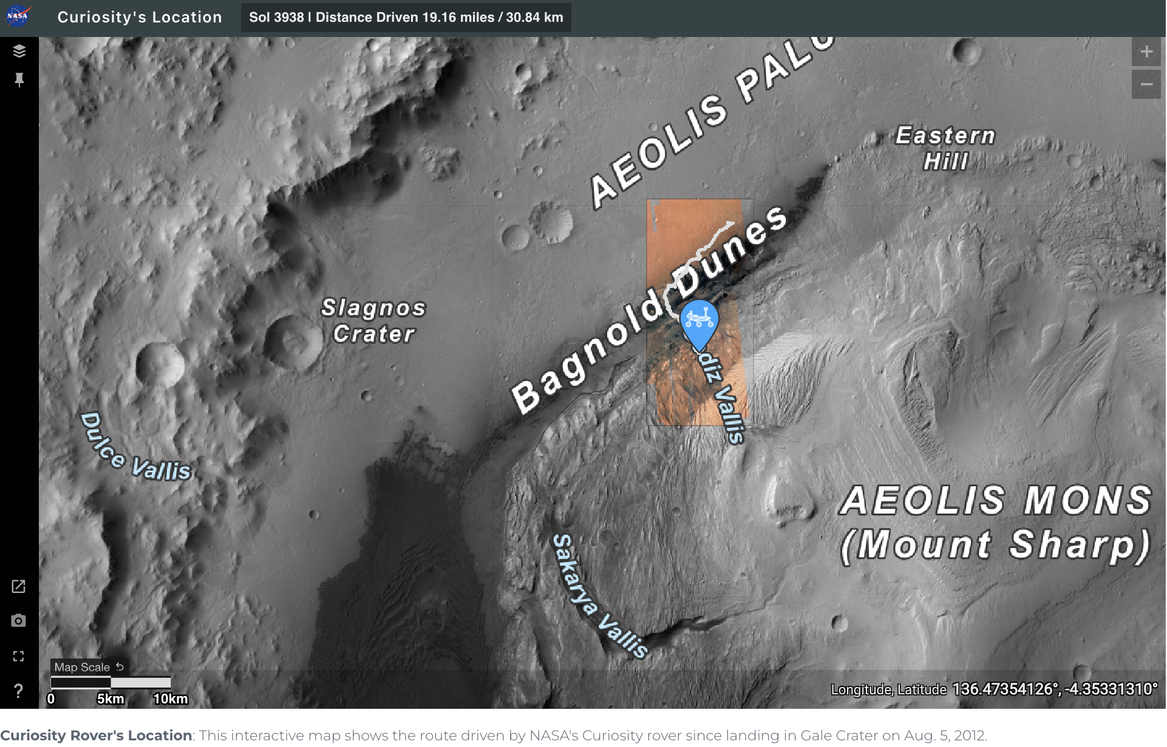
Curiosity As of September 2023

Slide 11
China’s Yinghuo-1 Orbiter and Russia’s Phobos-Grunt Phobos Sample Return Mission
Part of a cooperative space agreement between Russia and China
Launched together from Baikonur November 2011
Failed to initiate burn to leave Earth orbit
Disintegrated over the Pacific Ocean in January 2012

Slide 12
US MAVEN
Mars Atmosphere and Volatile Evolution
$582 million
Launched November 2013, orbited September 2014
Showed how water in the atmosphere is split to H₂ and O by solar radiation, H₂ rises and is stripped away by the solar wind

Slide 13
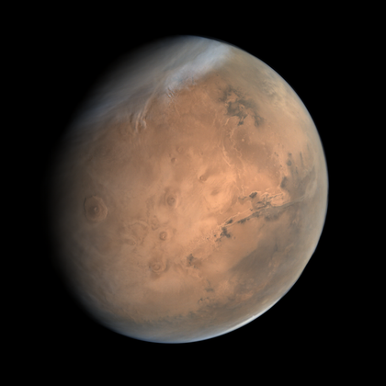
India’s Mars Orbiter Mission (Mangalyaan)
Built and operated by the Indian Space Research Organization (ISRO)
$73 million
Launched November 2013 from Satish Dhawan Space Center
Entered orbit around Mars in September 2014
Operated until April 2022
Instrumentation
  Visible and infrared cameras Lyman-alpha Photometer measured H and D in the atmosphere
  Methane sensor (fatal flaw in how data was returned to Earth)
  Mass-spectrometer measured altitude profiles of CO₂, CO, N₂ and O₂

Slide 14
US InSight Lander
Interior exploration using Seismic Investigations, Geodesy and Heat Transport
$830 million mission to place a seismometer and measure heat transfer with a deep probe
Launched May 2018, landed November 2018
Recorded 1,313 marsquakes, including one in May 2022 estimated at magnitude 5
Concluded that the core is partially molten, and the crust is thinner than expected and may have two or three sub-layers
The heat transfer probe was to be hammered 16 feet in with a percussive drill, which underperformed resulting in it going only about one foot deep rendering the science useless

Slide 15
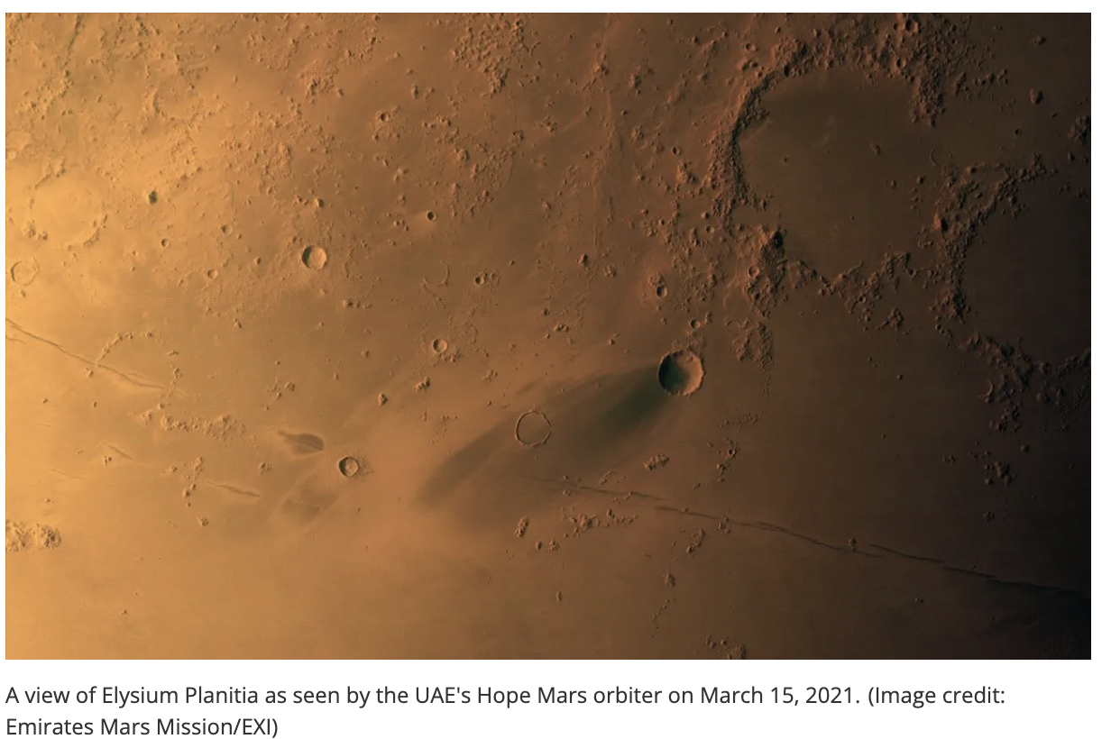
Emirati Hope
$200 million United Arab Emirates Mars orbiter
200 Emirati scientists and engineers design, developed, and operated the spacecraft under the Mohammed bin Rashid Space Centre
Assembled at the University of Colorado in cooperation with US engineers
Launched from Japan on July 2020 with orbit insertion in February 2021
Contains an imager and infrared and ultraviolet spectrometers
Imaged auroras, returned data on atmosphere, climate and dust storms

Slide 16
China Tianwen-1
Launched from the Wenchang Spacecraft Launch Site on the island of Hainan in July of 2020 on a Long March 5 heavy-lift launch vehicle, and entered Martian orbit in February of 2021
After studying landing sites, the lander touched down 25ᴼ north in Utopia Planitia in May 2021 using an aeroshell, supersonic parachute and retrorockets
Ten days later the Zhurong rover was deployed and explored for the planned 90 days, and continued out to one Earth year, then went into hibernation for the Martian winter
The orbiter has the usual array of instruments and continues to operate well as of Summer 2023

Slide 17
US Perseverance Rover
Similar to Curiosity and designed to explore Jezero Crater, the $2.2 billion spacecraft launched July 2020 and landed February 2021
EDL like Curiosity, but live streamed (3:05) for the first time and using cameras to control the landing site for the first time
Has an engraved caduceus in honor of Covid healthcare workers
Similar instrumentation to Curiosity with the addition of two microphones (3:15)
Cached samples for future Sample Return Mission
Added a helicopter named Ingenuity
Some findings
  Detected organic molecules in 2022: Raman and fluorescence spectroscopy found single-ring aromatics and polycyclic aromatic hydrocarbons
  Jezero Crater is made of igneous rocks containing olivine and pyroxene which are usually found in thick magma bodies, but these were changed by water since carbonate and sulfate minerals were also found
  On a typical Martian day at least four dust devils pass Perseverance peaking just after noon

Slide 18
Ingenuity Helicopter
Design and construction (3:27)
First flight (1:15) April 19, 2021
Designed to perform five flights and last 30 days
Still operating, including as a scout
As of September 2023, flew 55 times for a total of one hour and 40 minutes over a distance of 8 miles

Slide 19
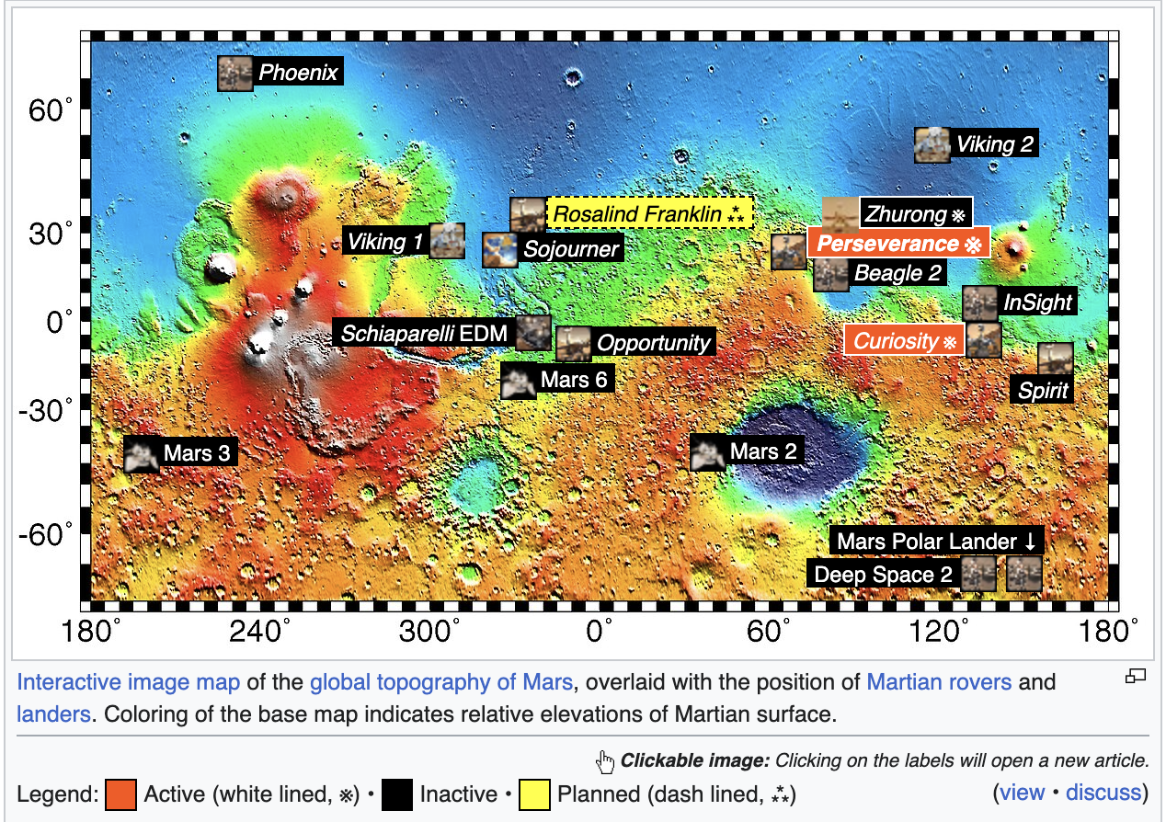
Summary of Mars Exploration
7 working orbiters, 3 working landers
2 working rovers, 1 working helicopter

Slide 20
Missions in Preparation
ESA Exo-Mars
  Part 1 was an orbiter launched in 2016 to study trace gasses and the Schiaparelli lander which crashed
  Part 2 is a Roscosmos lander designed to deliver the Rosalind Franklin rover, but in the Winter of 2022 the partnership was put on permanent hold due to sanctions against Russia for its invasion of Ukraine
US EscaPade
  To demonstrate low-cost planetary exploration ($79 million)
  Twin craft to investigate the magnetosphere and solar wind
  Planned for August 2024

Slide 21
Aspirational Mission: Sample Return
Main idea: Earth based laboratories have much greater capabilities than anything than can be flown to Mars
Perseverance has cached 22 samples for future return, including an atmospheric sample
Stored at on-board and at a backup site
Proposed sample retrieval mission (2026 or 2028)
  Sample Retrieval Lander + Sample Transfer arm + 2 Ingenuity class helicopters + Mars ascent vehicle
  Airbus Earth Return Orbiter from Mars orbit to Earth landing
  Simulation (1:24)
In June 2023, the cost of development doubled from $4.5 billion to $9 billion
China, Japan, France and Russia have all floated similar plans

Slide 22
Science Summary: Planet formation
Our solar system formed about 4.5 billion years ago from gravitational collapse of molecular gasses, about 98% from big bang hydrogen and helium and 2% from earlier stars which created heavier elements at the ends of their lives
Accretion from the disk-shaped cloud of gas and dust left over from solar formation formed “planetesimals” about 1/20th of Earth size containing iron, nickel, aluminum and silicates in the region near the Sun
The planetesimals collided and merged to form Mercury, Venus, Earth and Mars, but could not form planets in the asteroid belt region due to the effects of Jupiter’s gravity
From about 4 to 3.8 billion years ago many asteroids migrated inward producing the Late Heavy Bombardment, producing many craters on the rocky planets

Slide 23
Science Summary: Mars vs. Earth Internal Heat
Earth’s core is hot because of residual heat of formation and radioactive decay
The heat spreads from the core to the mantle, and a warm mantle has convection at the top, causing plate tectonics
Mars has about half of Earth’s diameter, and so has less internal heat
We were unable to ”take Mars temperature” because InSight’s heat transfer experiment failed.
Mars had plate tectonics and active volcanoes from about 4 billion years ago until about 3 billion years ago
Small, intermittent volcanic flows appear to have occurred as recent as a few tens of thousands of years ago, so future flows are possible
Frequent small to medium sized Marsquakes, mostly coming from Cerberus Fossae, also indicate that magma still flows in Mars mantle
On Earth plate tectonics recycles the water locked in minerals
(Venus has the most active volcanoes in the solar system but no plate tectonics and no magnetic field)

Slide 24
Science Summary: Mars vs. Earth Magnetic Field
On Earth convection of the liquid outer core creates the magnetosphere which protects the Earth from the solar wind
One theory says that multiple large asteroid strikes on Mars warmed the mantle, disrupting the convection of the core, and destroying the magnetosphere about 4 billion years ago
In the absence of a magnetosphere, the solar wind from removes gases from the atmosphere, especially water vapor
The loss of water vapor by the solar wind resulted in higher levels of heavy hydrogen (deuterium) on Mars compared to Earth
It is thought that Mars is dry because of a combination of loss of water from the atmosphere and lack of tectonic recycling of water
It appears that residual magnetism in rocks created during Mars’ prior period of a magnetic field cause ultraviolet auroras

Slide 25
Science Summary: Geologic Periods on Mars
Pre-Noachian (4.5 to 4.1 billion years ago)
  Formation of the “Martian dichotomy” (northern hemisphere is about 2 km lower than southern, and its crust is thinner) by impacts or plate tectonics
  Formation of Hellas basin, but most other effects lost to erosion and impacts
Noachian (4.1 to 3.7 billion years ago)
  Many impact craters
  Ocean(s), rivers, and erosion by water
Hesperian (3.7 to 3.1 billion years ago)
  Olympus Mons volcano
  Formation of extensive lava plains (and lava tubes and caves)
  Ephemeral lakes or seas in the northern lowlands
Amazonian (~3.1 billion years ago to present)
  Fewer impacts
  Lava flows, periods of glacial activity, small liquid water flows

Slide 26
Science Summary: Water and methane
Both ice caps are largely water ice, enough to cover the planet 36 feet deep
During winter, about 25% of the atmospheric CO₂ freezes as a cover over the water ice, then sublimes back to gas in the summer
The caps have spiral troughs due to Coriolis effect winds
Subsurface water ice is also present at high latitudes beyond the caps
Liquid water did flow in past and create landforms present today including dendritic networks, gullies, deltas, and alluvial fans
Sedimental and mineralogic evidence for past crater lakes is strong
Methane detection has been quite variable, but clearly methane is being formed now on Mars, because it decomposes to CO₂, H₂ and H₂O in a few hundred years due to UV radiation
It is unclear if methane production is geochemical or biological

Slide 27
Science Summary: Dust storms
Dust devils form often as sunlight heats rocks causing air close to the surface to rise into a column which is spun by horizontal winds
Dust storms can carry dust over large areas at up to 60 mph, especially in the summer
About every 3 Martian years these form into global dust storms
Due to the low atmospheric pressure this does not blow over equipment, people, etc., though it does significantly reduce the amount of sunlight
The dust is sticky and electrostatic so it can coat machinery and solar panels
Sometimes the wind blows dust off of equipment and solar panels

Slide 28
Science Summary: Radiation
The sievert is the unit of biological effect of ionizing radiation on tissue, often measured in thousandths (mSv)
The average yearly radiation dose for people is
  2.0 mSv by inhalation (radon)
  + 0.3 mSv by cosmic rays
  + 0.3 mSv by ingestion (food and water; 4 Brazil nuts per day)
  + 0.2 mSv from radioactivity in rocks around us
  2.8 mSv total
One chest x-ray is 0.1 mSv, one CT is 1.0 to 15.0 mSv
NASA allows a lifetime exposure of 1000 mSv (~4 times normal)
Low Earth orbit is 0.5 mSv per day (183 mSv per year)
Interplanetary space between Earth and Mars is 1.84 mSv per day or 750 mSv for a 14-month round trip
Average Mars surface radiation is 0.64 mSv/day or 83 times Earth radiation (one-way trip + 3 years = 1000 mSv)
Radiation is estimated to be one tenth as much in a lava tube
Radiation levels double after a solar storm (coronal mass ejection)

Slide 29
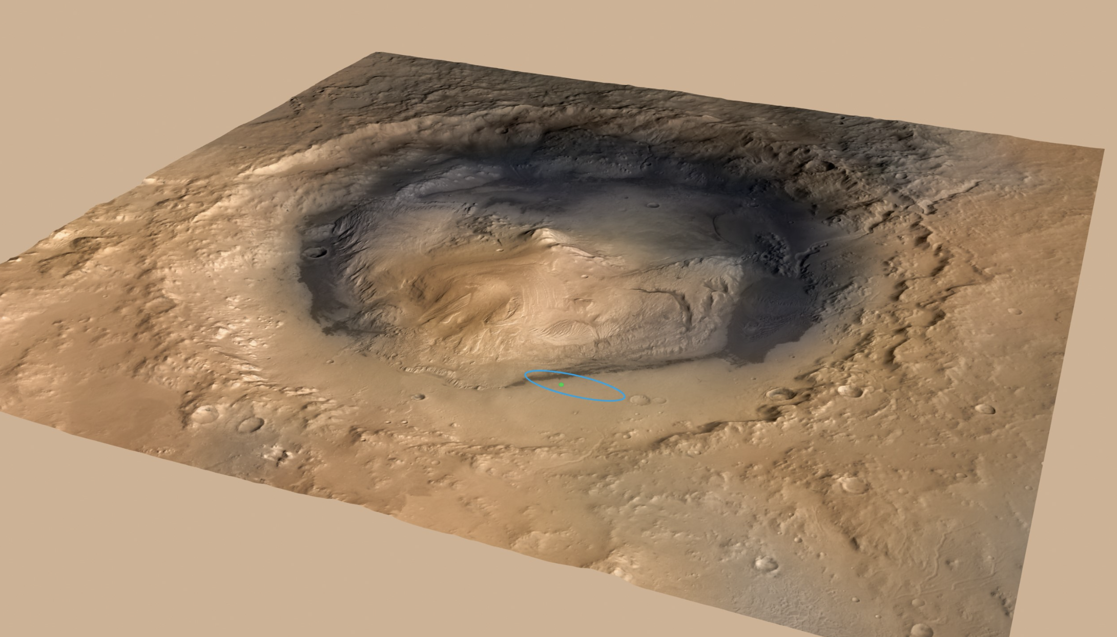
Science Example: Gale Crater
Site of Curiosity rover
Asteroid or comet impact 3.5 to 3.8 bya
Lowest layer is interstratified clay and sulfates
Conglomerates, cross-bedded sandstones, mudstones and a sandstone delta indicate an early period as a lake
Central mountain appears to be 2 billion years of lake sediment

Slide 30
Humans to Mars: Plans
NASA plans are vague and target the 2030’s using the Orion Multi-Purpose Crew Vehicle
NASA psychology tests started in 2009, current one is Mars Dune Alpha
The first launch of Elon Musk’s Mars-capable Space-X Starship ended in “unscheduled disassembly”, and the second launch is scheduled for September or October of 2023
Elon Musk plans for Mars: Elon Musk 2022 video (6:50)
Terraforming Mars
  Methods include adding greenhouse gasses, oxygen factories, and spreading dark absorbent dust from Phobos
  Additionally, some method to restart the magnetosphere would be need to prevent atmospheric losses
  Might only take 100,000 years

Slide 31
Humans to Mars: Concerns
Cumulative radiation exposure would be huge; effects include cancer and damage to the nervous system including altered cognition and behavior
Can humans live peaceably under crowded, uncomfortable conditions?
What will the Mars economy look like?
Will separate colonies compete or cooperate?
There will be no real-time communication with loved ones on Earth
The effects of long-term Mars gravity are unknown
Will opportunities to go to and work on Mars be equitable?
Will Earth continue to support Mars colonists indefinitely?
How long will it take to develop critical support technologies?
Do you want to live without being able to go outside, travel, etc.?
Does this divert attention and money from maintaining a healthy Earth?
What other concerns do you have?

Slide 32
Course Summary
Mars is difficult to get to and operate on, but incremental advances have resulted in moderately high success rates
Mars has a huge variety of landforms to explore
Several specific areas have been well explored, and subject to a wide variety of scientific testing
Astronauts on Mars seems reasonable in the next few decades
Elon Musk would like to have cities on Mars in that same time frame, but that seems unlikely

Slide 33
Curiosity Development
April 2004: Announcement of Opportunity for scientists and engineers from around the world to propose instruments
  Goals: quantitatively assess the habitability and environmental history of the landing site, characterize the geology, investigate planetary processes that influence habitability, and characterize surface radiation
  Components: cruise stage, aeroshell, descent stage with a sky crane, rover lasting at least one Martian year carrying a 128 pound science package split between an arm, a mast, and the rover body
  Excluding pre-specified Spanish meteorology package and Russian neutron spectrometer
  Robotic arm does sample acquisition, processing and handling (SA/SPaH)
  Radiothermal generator provides heat and electricity
  10 instruments chosen out of 48 proposed
Goal to reduce landing ellipse from MER’s 90 x 12 miles to 4 x 2 miles (final design: 12 x 4 miles) achieved with steerable aeroshell
Eventual workforce of 800 people
Changed from rock corer to percussive ”drill” to powder rocks
Changed from dry lubricant to old wet lubricant (requiring heat)
Changed from Super Light Ablator (corkwood, epoxy and gas filled silica glass spheres) to tiled Phenolic Impregnated Carbon Ablator

Slide 34
Curiosity Instrumentation
Explanations by Emily Lackdawalla, planetary geologist and space science journalist
Exploring Curiosity Part 1 (3:12)
Exploring Curiosity Part 2 (5:18)

Slide 35
Curiosity Subsequent Findings
Intermittently found up to 7 ppb of methane indicating a current source
SAM detected organic chemicals in drilled rocks, but specifics are complicated by the destructive effects of perchlorates
Examination of the Martian atmosphere confirmed that some meteorites that have dropped to Earth really are from the Red Planet
Rippled rocks represent waves in an ancient shoreline
Ahead is a debris field which will allow sampling of rocks from areas too high to climb

Slide 36
US MAVEN
Mars Atmosphere and Volatile Evolution
$582 million
Launched November 2013, orbited September 2014
Two-year mission (then extended) to measure the rate with which the atmosphere is currently escaping to space
Showed how water in the atmosphere is split to H₂ and O by solar radiation, H₂ rises and is stripped away by the solar wind
Showed a 10-fold variation in H₂ loss depending on distance from the sun
Detected a doubling of radiation during a solar storm

Slide 37
US InSight Lander
Interior exploration using Seismic Investigations, Geodesy and Heat Transport
$830 million mission to place a seismometer and measure heat transfer with a deep probe
Launched May 2018, landed November 2018
Took three months to deploy and commission the instruments
Terminated 2022 due to too much dust on the solar panels
Recorded 1,313 marsquakes, including one in May 2022 estimated at magnitude 5
Concluded that the core is partially molten, and the crust is thinner than expected and may have two or three sub-layers
The heat transfer probe was to be hammered 16 feet in with a percussive drill, which underperformed resulting in it going only about one foot deep rendering the science useless

